Slide 1
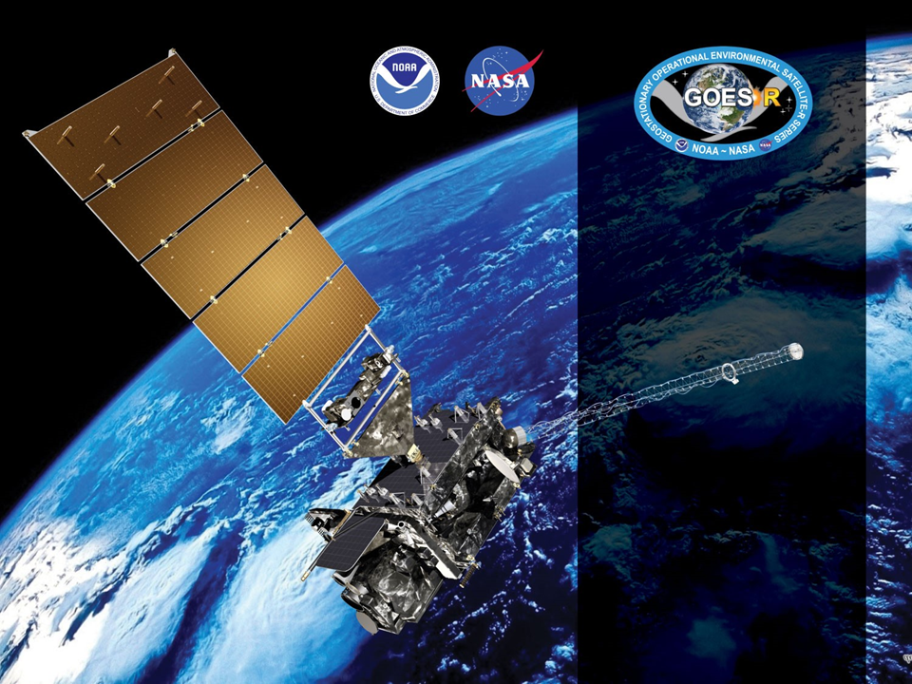
GOES-19 ABI L2+ SW Radiation Budget (SRB)
Provisional PS-PVR
March 12, 2025
GOES-R AWG
Istvan Laszlo¹, Hye-Yun Kim², Hongqing Liu², Rachel Pinker³, Kathy Lantz⁴ and the PRO Team
¹NOAA/NESDIS/STAR, ²STC, ³University of Maryland, ⁴NOAA/OAR/ESRL

Slide 2
Outline
Product Overview
Review of ADRs
Provisional Maturity Assessment
  Comparison with other satellite and reference data
Path to Full Validated Maturity
Summary and Recommendations

Slide 3
Product Overview: RSR
Reflected Shortwave Radiation: Top-Of-Atmosphere
  instantaneous SW (0.2-4.0 µm) flux emerging at the Earth’s TOA,
  produced at the 2-km ABI pixel resolution every 10 minutes for Full Disk.
    Enterprise Processing System (EPS) products.
  SRB Enterprise algorithm description is not yet available in Product Definition and User’s Guide (PUG).
Table 2.5. in Algorithm Theoretical Basis Document for enterprise processing system version (09/28/20)^{[2]}
 | Measurement |  |  |  | Mapping
Region | Range | Accuracy | Precision | Performance Conditions | Accuracy
Full Disk | 0 to 1300 W/m² | 85 W/m² at high end of range (>500 W/m²) 65 W/m² at middle of range (200-500 W/m²) 110 W/m² at low end of range (<200 W/m²)^{[2]} | 100 W/m² for high end of range (>500 W/m²) 130 W/m² for middle of range (200-500 W/m²) 100 W/m² for low end of range (<200 W/m²) | LZA ≤ 70 degrees, daytime ^{[1]} | Full Disk: 2 km
[1] Conditions for good quality prescribed by the algorithm are for SZA ≤ 70 degrees.
[2] Available at: https://www.star.nesdis.noaa.gov/goesr/documentation_ATBDs.php.

Slide 4
Product Overview: DSR
Downward Shortwave Radiation: Surface
  instantaneous SW (0.2-4.0 µm) flux received at the Earth’s surface,
  produced at the 2-km ABI pixel resolution every 10 minutes for Full Disk.
    Enterprise Processing System (EPS) products.
  SRB Enterprise algorithm description is not yet available in Product Definition and User’s Guide (PUG).
Table 2.1. in Algorithm Theoretical Basis Document for enterprise processing system version (09/28/20)^{[2]}
 | Measurement |  |  |  | Mapping
Region | Range | Accuracy | Precision | Performance Conditions | Accuracy
Full Disk | 0 to 1500 W/m² | 85 W/m² at high end of range (>500 W/m²) 65 W/m² at middle of range (200-500 W/m²) 110 W/m² at low end of range (<200 W/m²)^{[2]} | 100 W/m² for high end of range (>500 W/m²) 130 W/m² for middle of range (200-500 W/m²) 100 W/m² for low end of range (<200 W/m²) | LZA ≤ 70 degrees, daytime ^{[1]} | Full Disk: 2 km
[1] Conditions for good quality prescribed by the algorithm are for SZA ≤ 70 degrees.
[2] Available at: https://www.star.nesdis.noaa.gov/goesr/documentation_ATBDs.php.

Slide 5
Product Overview: PAR
Photosynthetically Active Radiation
  instantaneous visible (0.4-0.7 µm) flux received at the Earth’s surface,
  produced at the 2-km ABI pixel resolution (2 km) every 10 minutes for Full Disk.
    New product in Enterprise Processing System (EPS) and not yet available at AWS.
  SRB Enterprise algorithm description is not yet available in Product Definition and User’s Guide (PUG).
Table 2.3. in Algorithm Theoretical Basis Document for enterprise processing system version (09/28/20)^{[2]}
 | Measurement |  |  |  | Mapping
Region | Range | Accuracy | Precision | Performance Conditions | Accuracy
Full Disk | 0 to 700 W/m² | 55 W/m² at high end of range (>250 W/m²) 45 W/m² at middle of range (100-250 W/m²) 70 W/m² at low end of range (<100 W/m²)^{[2]} | 65 W/m² for high end of range (>250 W/m²) 85 W/m² for middle of range (100-250 W/m²) 65 W/m² for low end of range (<100 W/m²) | LZA ≤ 70 degrees, daytime ^{[1]} | Full Disk: 2 km
[1] Conditions for good quality prescribed by the algorithm are for SZA ≤ 70 degrees.
[2] Available at: https://www.star.nesdis.noaa.gov/goesr/documentation_ATBDs.php.

Slide 6
GOES-R DSR/RSR/PAR Product
Precedence Chain
Cloud phase, optical depth, droplet size, top height
ABI
Climatology
4-level Cloud Mask
Cloud & Moisture Imagery
DSR
RSR
PAR
Snow Mask
ABI FSC product
GFS water equivalent snow depth
TPW
ABI product
GFS product
Climatology
Indirect Path Algorithm

Slide 7
Pre-Provisional Time-Line
25 Jun 2024 GOES-U Launch
7 Jul 2024 Renamed GOES-19
18 Jul 2024 Reached test position at 89.5° W
1 Oct 2024 GOES-19 SRB Beta Maturity
20 Dec 2024 L1b data reached Provisional
29 Jan 2025 Clear-sky mask reached Provisional
12 Mar 2025 GOES-19 SRB PS-PVR Provisional

Slide 8
ADRs IN PROGRESS PRIOR TO GOES-19 SRB PROVISIONAL REVIEW
GOES-19 Shortwave Radiation Budget L2 Product Provisional PS-PVR

Slide 9
ADRs in Progress
Title | Description (date submitted) | Impact | Mitigation | Status
ADR1489 | ClearInstAlb (time-series of clear sky instantaneous TOA albedo) is reset when ABI mode change from Mode 6 to Mode 4 or the other way (09/11/24) | Missing ClearCompAlb impacts flux retrieval quality. | TBD | In analysis
ADR1521 | Flux is retrieved in missing block/stripe in upstream input products or flux retrieval is not attempted when upstream input products have valid retrievals (11/07/24) | Incorrect retrieval hinders usage and getting information from it. | TBD | In analysis
Little Impact
Moderate Impact
Big Impact
ADRs apply to G16, G18 and G19.

Slide 10
Product Quality Evaluation
GOES-19 Shortwave Radiation Budget L2 Product Provisional PS-PVR

Slide 11
Provisional PLPTs
Test ID | Short description | 16 | 17 | 18 | 19
ABI-FD_DSR01 ABI-FD_RSR01 ABI-FD_PAR01^ | Verify that Mode 6 FD products are within range | B | P | P | P
ABI-CONUS_DSR02 ABI-CONUS_RSR02 | Verify that Mode 6 CONUS products are within range | B | P | P^ | N/A
ABI-MESO_DSR03 | Verify that Mode 6 mesoscale products are within range | B | P* | N/A^ | N/A
ABI-FD_DSR04 ABI-FD_RSR04 ABI-FD_PAR04^ | Verify that Mode 4 FD products are within range | B | P | P | P
ABI-CONUS_DSR05 ABI-CONUS_RSR05 | Verify that Mode 4 CONUS products are within range | B | P | P^ | N/A
ABI-FD_DSR06 ABI-FD_RSR06 ABI-FD_PAR06^ | Assessment of FD accuracy and precision | B, P, F | P, F | P, F | P, F
ABI-CONUS_DSR07 ABI-CONUS_RSR07 | Assessment of CONUS accuracy and precision | B, P, F | P, F | P, F^ | N/A
ABI-MESO_DSR08 | Assessment of mesoscale accuracy and precision | B, P, F | P* | N/A^ | N/A
B, P, F indicate test is required for Beta, Provisional, Full maturity.
* Evaluation of MESO product was attempted but ultimately not possible to perform during GOES-17/18 Provisional testing due to an incorrect mapping issue.
^ With implementation of the Enterprise version of the algorithm, the PAR product is added, and the MESO and CONUS products are decommissioned. RIMP/PLPT tests 02, 03, 05, 07 and 08 do not apply for GOES-19.
Reference: Geostationary Operational Environmental Satellite (GOES) – R Series ABI L2+ Surface Downward Shortwave Radiation and Top-of-Atmosphere Reflected Shortwave Radiation (DSR-RSR) Beta, Provisional and Full Validation Readiness, Implementation and Management Plan (RIMP) (v2.0; 410-R-RIMP-0327, Oct 6,2021).

Slide 12
Application of PLPT Analysis
Tests to Domains
Analysis Method |  | FD
Visual | Inspection for range
 | Comparison with GOES-16
Quantitative | Comparison with GOES-16
 | Comparison of GOES-19 DSR with ground measurements (SURFRAD and SOLRAD)
 | Comparison of GOES-19 PAR with ground measurements (SURFRAD)
 | Comparison of GOES-19 RSR with CERES RSR
CERES: Clouds and the Earth Radiant Energy System
SURFRAD: Surface Radiation Budget Network (US)
SOLRAD: Solar radiation network (US)

Slide 13
GOES-19 Data Used in this Review
G19 DSR, RSR, and PAR in FD.
Time period: 10/29/24 – 01/15/25
  G19 L1b reached Beta maturity on 10/01/24
    SRB algorithm requires 29-day of clear sky TOA albedo time-series
Matchups (set of quasi coincident and collocated G19 and reference data):
  RSR with CERES observations.
  DSR with SURFRAD and SOLRAD measurements.
    G19 data are spatially averaged within an area of 25-km radius centered on ground site.
    Reference data are temporally averaged within ±30-min centered on G19 retrieval time.
  PAR with SURFRAD measurements.
    Same as DSR

Slide 14
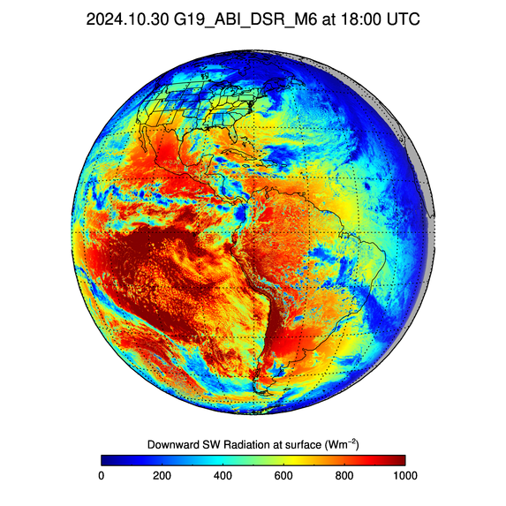
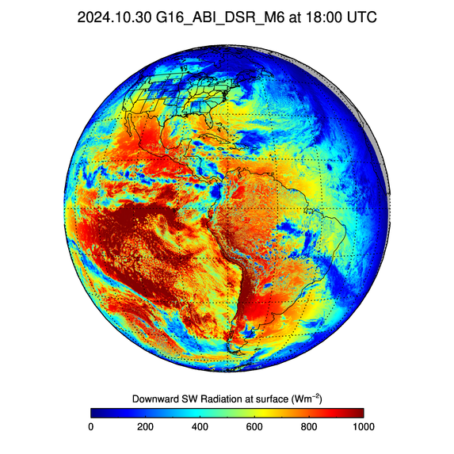
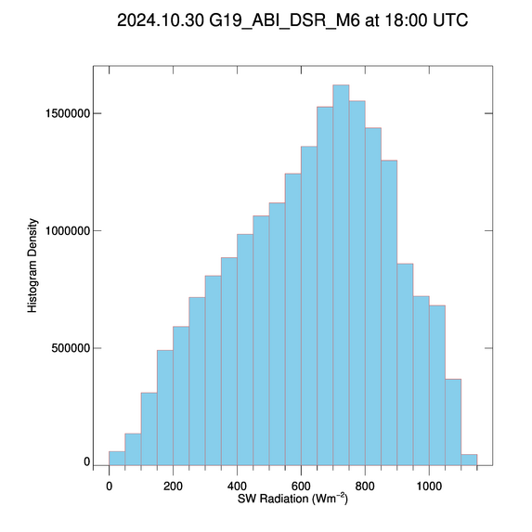
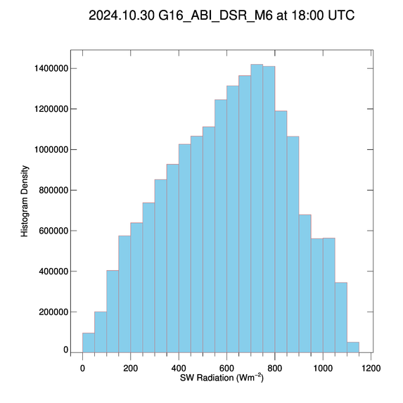
G19/G16 FD DSR Comparison 18 UTC on 10/30/24
PLPT test ABI-FD_DSR01
G19 remapped to G16 position.
G19 and G16 Full Disk (FD) DSRs are visually similar.
G19 DSR is in expected range.
Distributions of good quality FD DSR from G19 and G16 are similar.

Slide 15
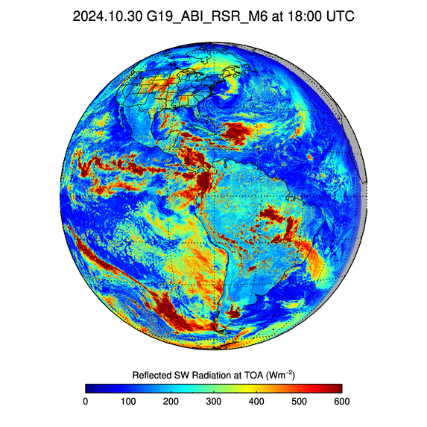
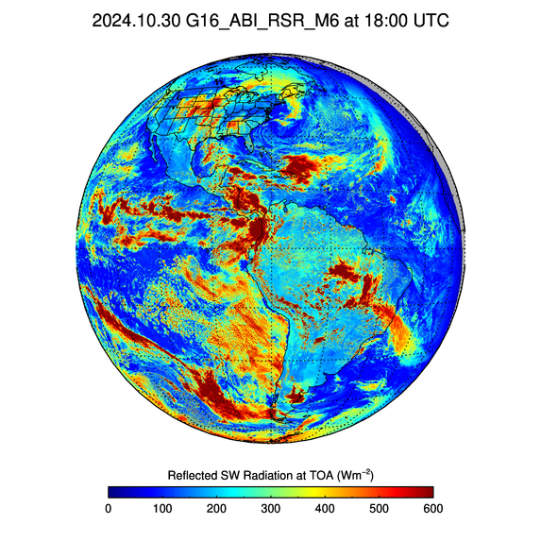
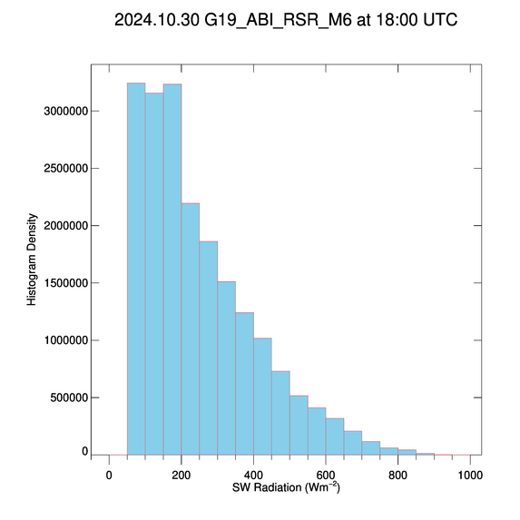
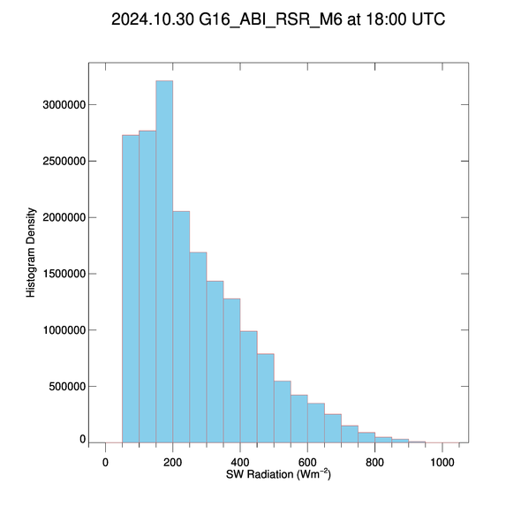
G19/G16 FD RSR Comparison 18 UTC on 10/30/24
PLPT test ABI-FD_RSR01
G19 remapped to G16 position.
G19 and G16 Full Disk (FD) RSRs are visually similar.
G19 RSR is in expected range.
Distributions of good quality FD RSR from G19 and G16 are similar.

Slide 16
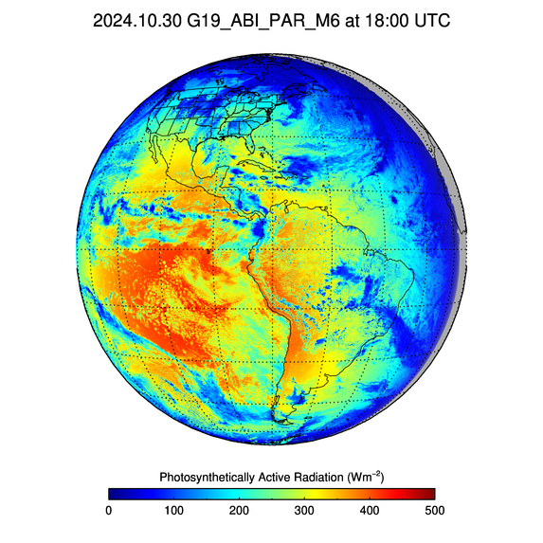
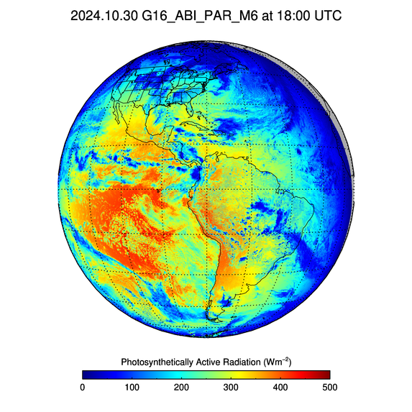
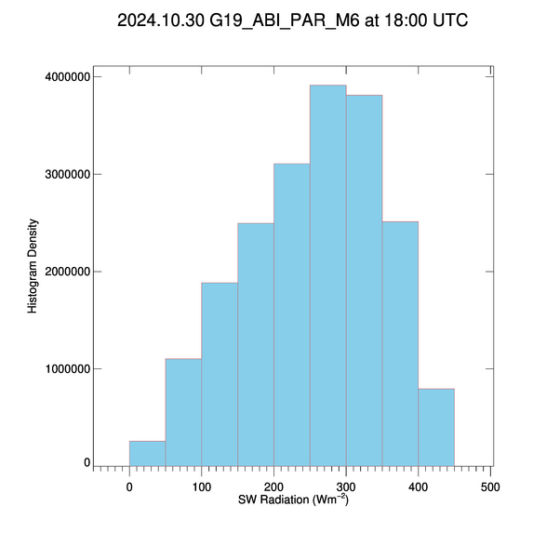
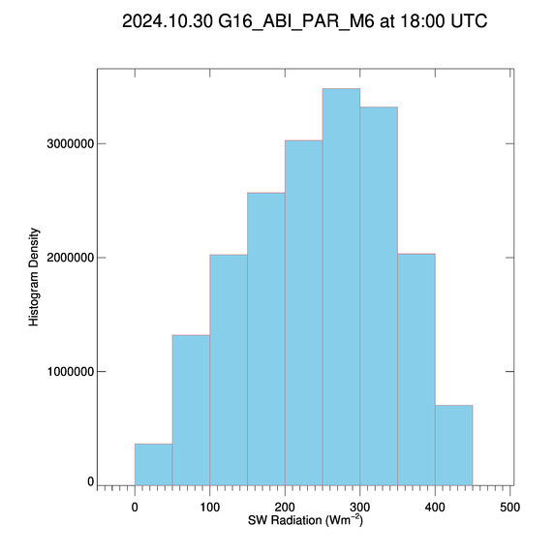
G19/G16 FD PAR Comparison 18 UTC on 10/30/24
PLPT test ABI-FD_PAR01
G19 remapped to G16 position.
G19 and G16 Full Disk (FD) PARs are visually similar.
G19 PAR is in expected range.
Distributions of good quality FD PAR from G19 and G16 are similar.

Slide 17
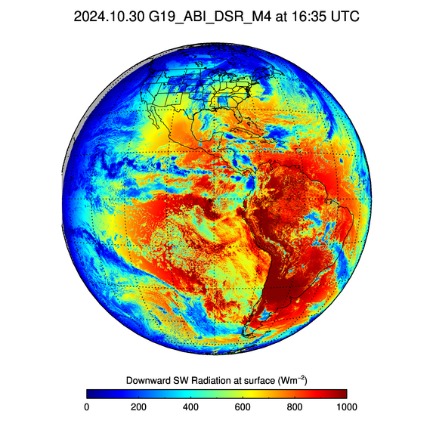
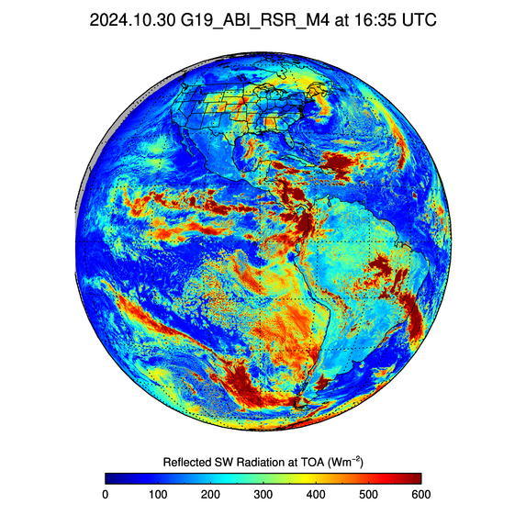
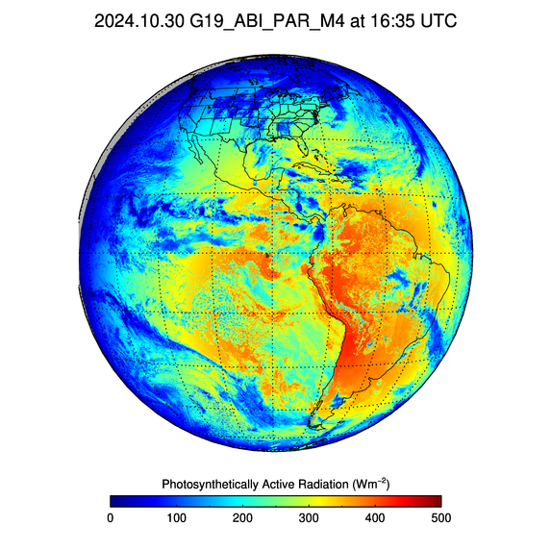
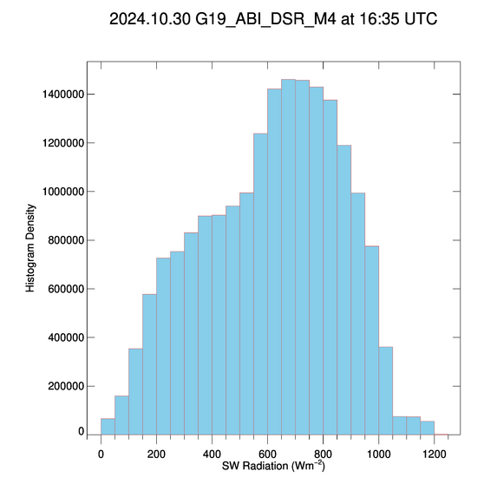
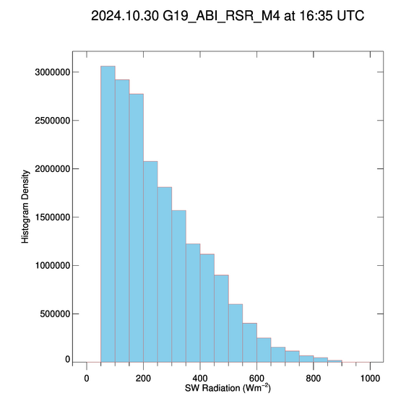
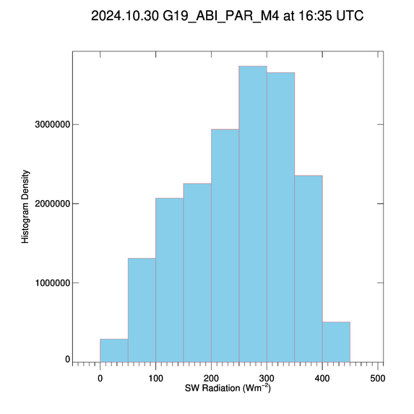
G19 M4 16:35 UTC on 10/30/24
PLPT tests ABI-FD_DSR04, _RSR04, and _PAR04
G19 M4 Full Disk (FD) DSR, RSR, and PAR are in expected range.
Distributions of good quality fluxes from M4 FD shown in the histograms are similar to those from M6 FD.

Slide 18
Summary of PLPT tasks 01 and 04
Tasks ABI-FD_DSR01, ABI-FD_RSR01, ABI-FD_PAR01:
  G19 FD M6 DSR, RSR, and PAR are within required measurement range.
  G19 and G16 FD DSRs, RSRs and PARs are visually similar.
Tasks ABI-FD_DSR04, ABI-FD_RSR04, ABI-FD_PAR04 :
  G19 FD M4 DSR, RSR, and PAR are within required measurement range.
  Distributions of M4 FD DSR, RSR, and PAR are similar to those from M6 FD.

Slide 19
Comparison with Reference data
GOES-19 Shortwave Radiation Budget L2 Product Provisional PS-PVR

Slide 20
Definitions of Metrics for Quantitative Comparisons
Passed: Accuracy and Precision meet or slightly exceed requirements. Potential contributors for deviations are identified.
Partial-Passed: Accuracy/Precision deviates significantly from requirements, but potential contributors for deviations are identified.
Failed: Accuracy/Precision deviates significantly from requirements and source of poor performance is unknown, or source known and correction requires new algorithm.

Slide 21
Comparison of GOES-19 RSR with CERES RSR
GOES-19 Shortwave Radiation Budget L2 Product Provisional PS-PVR

Slide 22
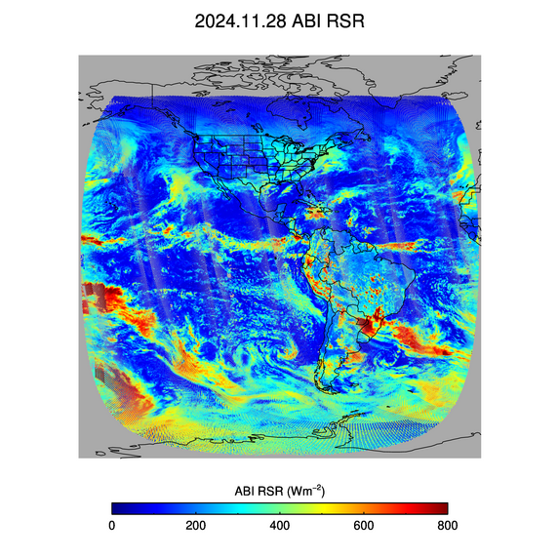
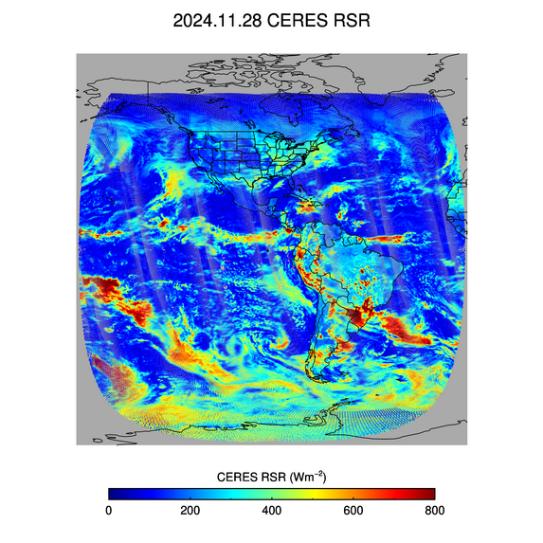
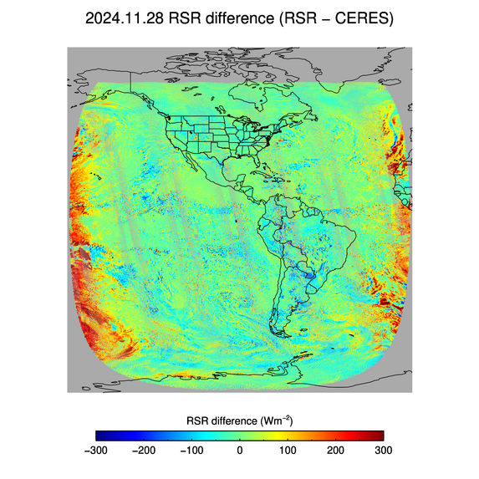
PLPT Task ABI-FD_RSR06
Comparison of G19 RSR with CERES/NOAA20 TOA reflected flux on 11/28/2024 over full disk:
  G19 (left), CERES (middle), and G19 – CERES difference (right).
  Largest differences (± 300 Wm⁻²) are over clouds and near the terminator. ABI “sees” clouds near the terminator where CERES does not, which causes overestimation.

Slide 23
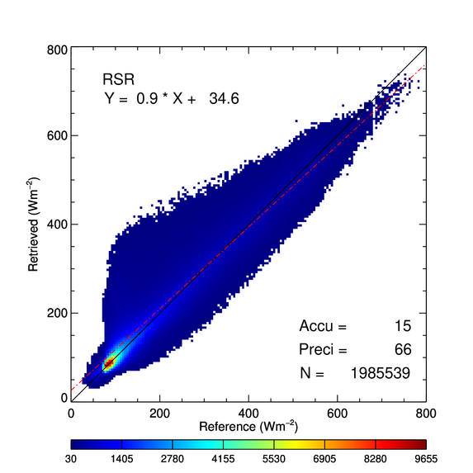
PLPT Task ABI-FD_RSR06
Comparison of G19 FD RSR product with CERES/NOAA20 TOA fluxes for 11/28/2024 over full disk.
Range | A | P | N
CERES < 200 | 24 (110) | 59 (100) | 1,031,686
[200, 500] | 11 (65) | 71 (130) | 790,462
CERES > 500 | -16 (85) | 71 (100) | 163,391
Requirements are in parenthesis. Units: W m⁻².
Only one day, but large N!
Accuracy (A) and precision (P) are within specs.
    Overestimation in low RSR range is from difference in scene types between ABI and CERES near the ABI terminator.
Accuracy (A): mean bias (satellite – reference)
Precision (P): standard deviation of biases
Number (N): number of samples

Slide 24
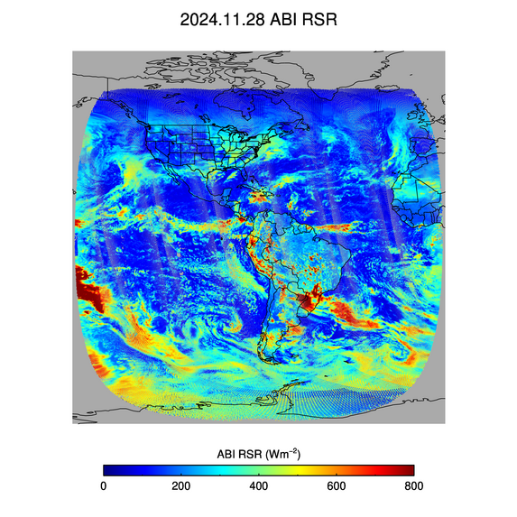
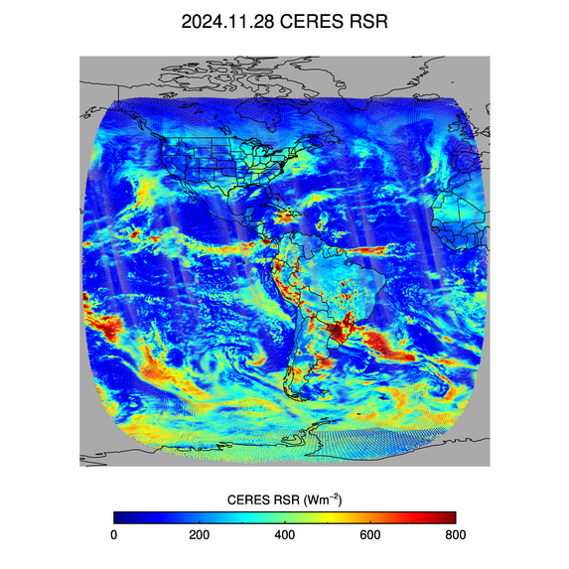
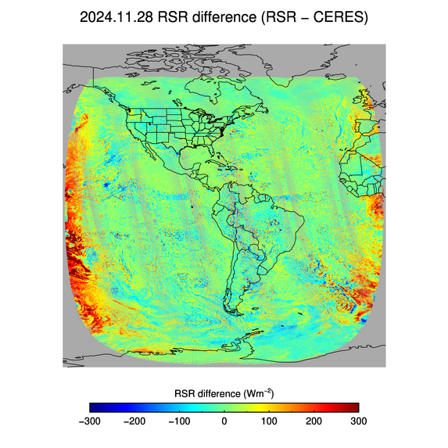
PLPT Task ABI-FD_RSR06
Comparison of G16 RSR with CERES/NOAA20 TOA reflected flux on 11/28/2024 over full disk:
  G16 (left), CERES (middle), and G16 – CERES difference (right).
  Largest differences (± 300 Wm⁻²) are over clouds and near terminator. ABI “sees” clouds near terminator where CERES does not.
  Similar to G19 RSR error patterns

Slide 25
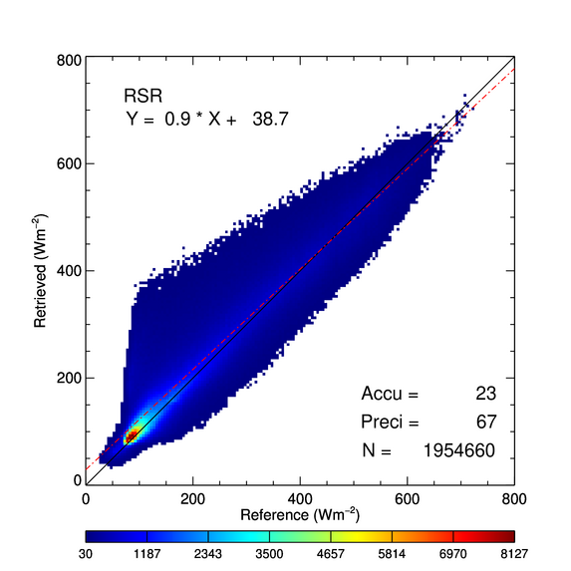
PLPT Task ABI-FD_RSR06
Comparison of G16 FD RSR product with CERES/NOAA20 TOA fluxes for 11/28/2024 over full disk.
Range | A | P | N
CERES < 200 | 29 (110) | 61 (100) | 972,855
[200, 500] | 20 (65) | 71 (130) | 822,824
CERES > 500 | -4 (85) | 73 (100) | 158,981
Requirements are in parenthesis. Units: W m⁻².
Accuracy (A) and precision (P) are similar to G19.
Overestimation in low RSR range is from difference in scene types between ABI and CERES near the ABI terminator.
Accuracy (A): mean bias (satellite – reference)
Precision (P): standard deviation of biases
Number (N): number of samples

Slide 26
PLPT Task ABI-FD_RSR06
Comparison of G19 FD RSR product with CERES/NOAA20 TOA fluxes for the time period 10/29/2024 – 01/15/2025 over ground stations.
  Number of samples (N) are smaller compared to full disk comparison.
Accuracy (A) and precision (P) are within specs.
G19 A&P statistics are similar to G16 A&P statistics.
G19
Range | A | P | N
CERES < 200 | 3 (110) | 44 (100) | 3551
[200, 500] | -14 (65) | 40 (130) | 3378
CERES > 500 | -38 (85) | 34 (100) | 24
G16
Range | A | P | N
CERES < 200 | 3 (110) | 28 (100) | 3707
[200, 500] | -3 (65) | 41 (130) | 3569
CERES > 500 | -16 (85) | 32 (100) | 25
Requirements are in parenthesis. Units: W m⁻².
Accuracy (A): mean bias (satellite – reference)
Precision (P): standard deviation of biases
Number (N): number of samples

Slide 27
Comparison of GOES-19 DSR with SURFRAD and SOLRAD DSR
GOES-19 Shortwave Radiation Budget L2 Product Provisional PS-PVR

Slide 28
Reference Data for
Quantitative Evaluation of DSR
Surface Radiation Network (SURFRAD)
  Accurate, long-term, continuous measurements.
  7 permanent sites in climatologically diverse regions in the US.
Integrated Surface Irradiance Study (SOLRAD)
  Monitors surface radiation in the US, in collaboration with SURFRAD.
  7 stations are available.

Slide 29
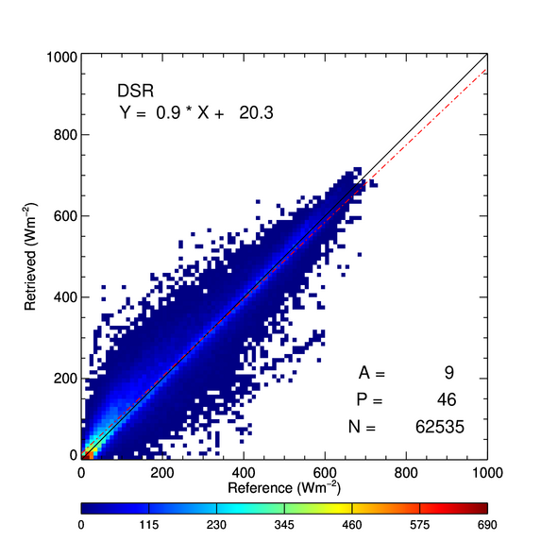
PLPT Task ABI-FD_DSR06
Comparison of FD DSR product with SURFRAD and SOLRAD for 10/29/2024 – 01/15/2025.
Range | A | P | N
Ground < 200 | 18 (110) | 42 (100) | 34,153
[200, 500] | -1 (65) | 51 (130) | 22,727
Ground > 500 | -3 (85) | 37 (100) | 5,655
Requirements are in parenthesis. Units: W m⁻².
Accuracy (A) and Precision (P) requirements are met in all ranges.
Accuracy (A): mean bias (satellite – reference)
Precision (P): standard deviation of biases
Number (N): number of samples

Slide 30
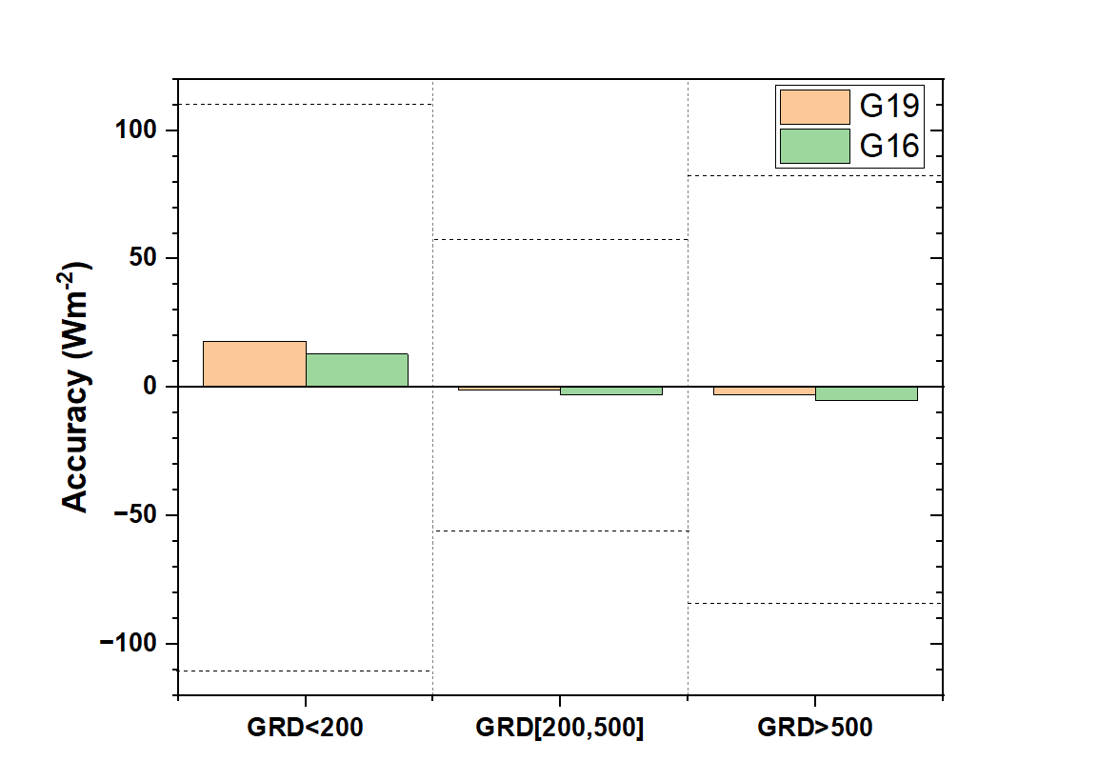
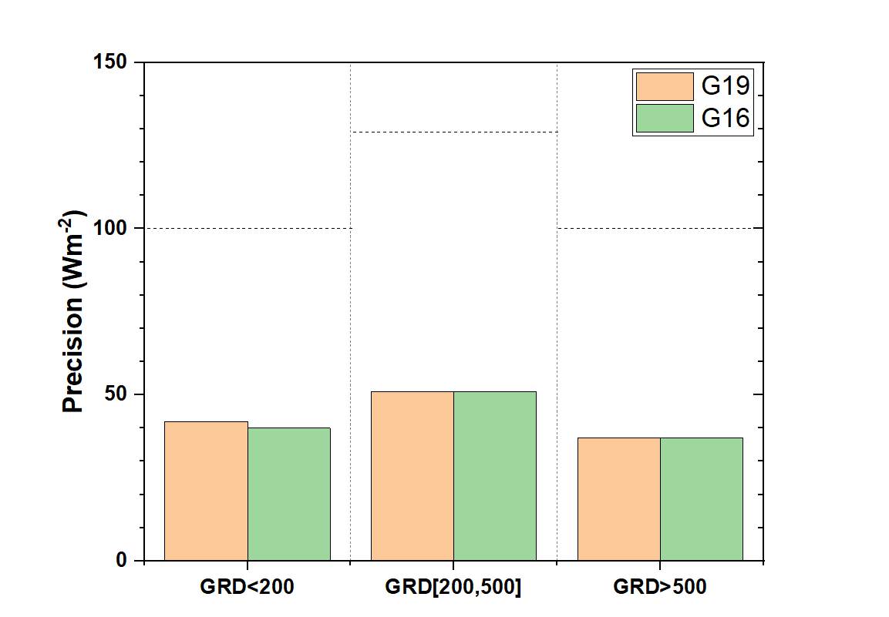
G19 and G16 DSR comparison over the same ground stations
DSR from G19 and G16 for 10/29/2024 – 01/15/ 2025 compared with ground measurements.
  G19 A and P are comparable to G16 A and P.
Dotted horizontal lines represent requirements.

Slide 31
Comparison of GOES-19 PAR with SURFRAD PAR
GOES-19 Shortwave Radiation Budget L2 Product Provisional PS-PVR

Slide 32
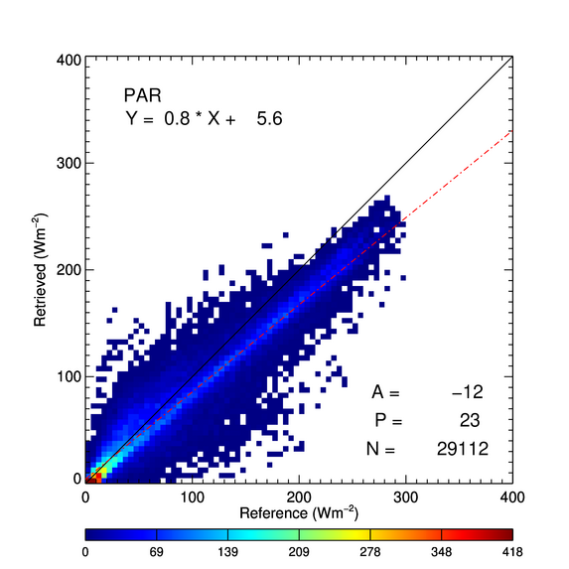
PLPT Task ABI-FD_PAR06
Comparison of FD PAR product with SURFRAD for 10/29/2024 – 01/15/2025.
Range | A | P | N
Ground < 100 | -1 (70) | 18 (65) | 17025
[100, 250] | -27 (45) | 21 (85) | 11333
Ground > 250 | -38 (55) | 14 (65) | 754
Requirements are in parenthesis. Units: W m⁻².
Accuracy (A) and Precision (P) requirements are met in all ranges.
Accuracy (A): mean bias (satellite – reference)
Precision (P): standard deviation of biases
Number (N): number of samples

Slide 33
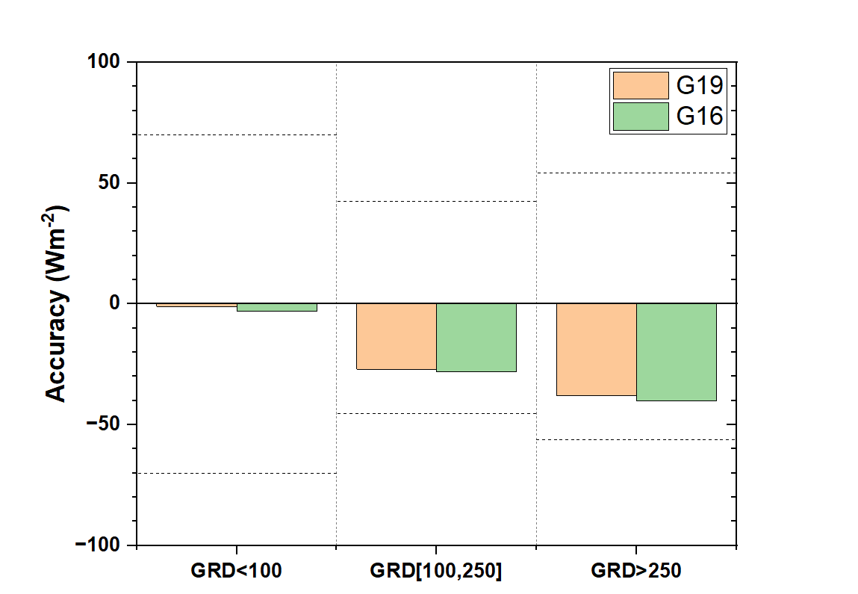
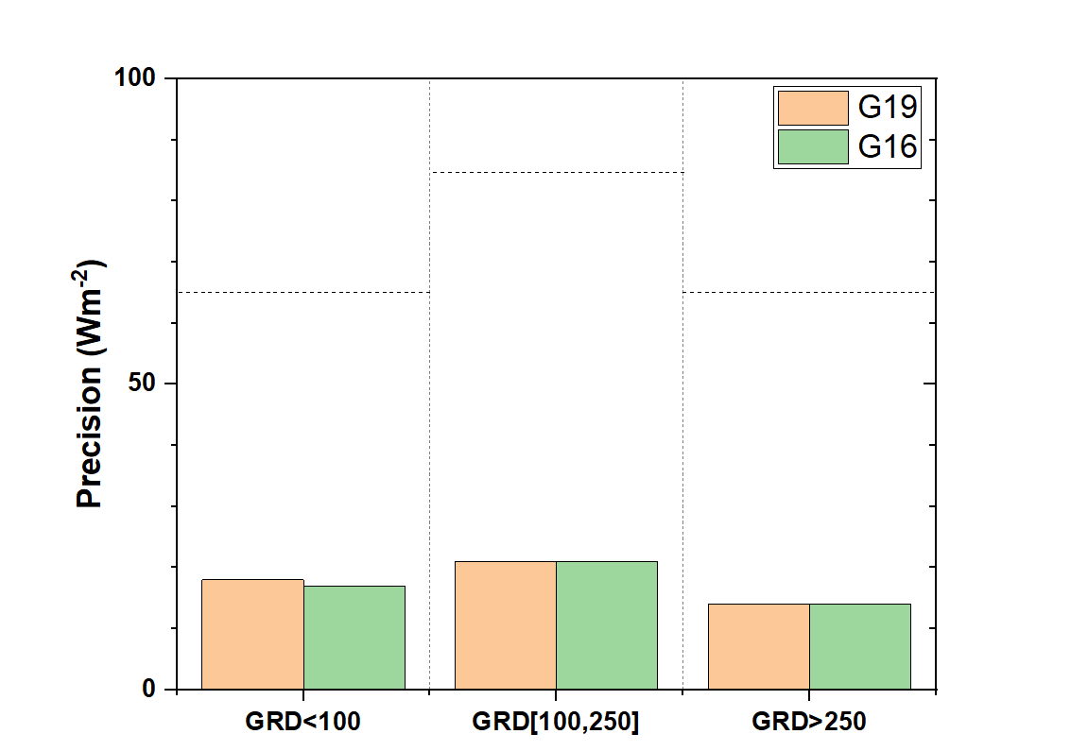
G19 and G16 PAR comparison over the same ground stations
PAR from G19 and G16 for 10/29/2024 – 01/15/ 2025 compared with ground measurements.
  G19 A and P are comparable to G16 A and P.
Dotted lines represent requirements.

Slide 34
Summary of G19 vs. Reference RSR, DSR, and PAR Comparison
G19 RSR is evaluated with CERES RSR (Passed).
  A and P are within specs for all ranges.
  Quality of G19 RSR is very similar to quality of G16 RSR.
G19 DSR is evaluated with SURFRAD and SOLRAD ground data (Passed).
  A and P are within specs in ~ 2.5-month data.
  Quality of G19 DSR is very similar to quality of G16 DSR.
G19 PAR is evaluated with SURFRAD ground data (Passed).
  A and P are within specs in ~ 2.5-month data.
  Quality of G19 DSR is very similar to quality of G16 DSR.

Slide 35
Provisional Maturity Assessment
GOES-19 Shortwave Radiation Budget L2 Product Provisional PS-PVR

Slide 36
Provisional Validation
Preparation Activities | Assessment
Validation activities are ongoing and the general research community is now encouraged to participate. | Validation activities are ongoing.
Severe algorithm anomalies are identified and under analysis. Solutions to anomalies are in development and testing. | No severe anomalies identified.
Incremental product improvements may still be occurring. | Incremental product improvements are expected.
Users are engaged in the Product Feedback Forums and user feedback is assessed | No feedback from users yet.

Slide 37
Provisional Validation
End State | Assessment
Product performance has been demonstrated through analysis of a small number of independent measurements obtained from select locations, periods, and associated ground truth or field campaign efforts. | This has been demonstrated using CERES, SURFRAD and SOLRAD as truth and independent statellite retrivals from GOES-16 and GOES-18.
Product analysis is sufficient to communicate product performance to users relative to expectations (Performance Baseline). | Concur.
Documentation of product performance exists that includes recommended remediation strategies for all anomalies and weaknesses. Any algorithm changes associated with severe anomalies have been documented, implemented, tested, and shared with the user community. | These are documented in this PS-PVR presentation and will be documented in a separate ReadMe file.
Testing has been fully documented. | Concur (in PS-PVR slides).
Product is ready for operational use and for use in comprehensive cal/val activities and product optimization. | Concur.

Slide 38
Path to full Validation Maturity
GOES-19 Shortwave Radiation Budget L2 Product Provisional PS-PVR

Slide 39
Issues and Status
ADRs Potentially Needing Resolution for Full VAL
ADR | Title | Status | Build
1489 | ClearInstAlb reset when ABI mode changes | In analysis | --
1521 | Occasional blocks of missing retrievals | In analysis | --

Slide 40
Issues and Status
Other Actions Needed for Full VAL
Action | Title | Desired Implementation Date into OE
N/A | L2 SRB algorithm - update the narrow-to-broadband (NTB) albedo conversion for G19 ABI | ≧6 month prior to PS-PVR FULL
The Enterprise algorithm uses empirical narrow-to-broadband conversions, but currently that is derived from G16 ABI data. It needs to be derived from G19 ABI data, which will need to be established for a long record (several month of data).

Slide 41
Path to Full Validation - PLPTs
PLPT ID | Descriptive Title
ABI-FD_DSR06 ABI-FD_RSR06 ABI-FD_PAR06^ | Assess precision and accuracy of FD product for an extended period that includes seasonally representative number of independent measurements
^ With implementation of the Enterprise version of the algorithm, the PAR product is added.
AWG SRB Team will conduct these tests to further evaluate the L2 SRB product quality.
Full description of test plans and procedures are given in the Geostationary Operational Environmental Satellite (GOES)-R Series ABI L2+ Surface Downward Shortwave Radiation and Top-of-Atmosphere Reflected Shortwave Radiation (DSR-RSR) Beta, Provisional and Full Validation Readiness, Implementation and Management Plan (RIMP) (v2.0; 410-R-RIMP-0327, Oct 6,2021).

Slide 42
Path to Full Validation – Risks
Risk Name | Description | Impact | Mitigation and Schedule
Update NTB coefficients | as discussed; Priority 1 | Moderate | Extend G19 record used for developing empirical NTB; ≧6 month prior to PS-PVR FULL
NTB: narrowband-to-broadband
Little Impact
Moderate Impact
Big Impact

Slide 43
Summary & Recommendations
GOES-19 Shortwave Radiation Budget L2 Product Provisional PS-PVR

Slide 44
Summary
Measured FD DSR, RSR, and PAR performance against reference data
  Accuracy and precision specs are met in all ranges of DSR, RSR, and PAR.
  Updates will be needed for the narrow-to-broadband (NTB) transformation to further improve performance. Requires collection of more GOES-19 ABI and CERES data.
Overall, the GOES-19 FD DSR, RSR, and PAR products are ready for operational and scientific use
  In general, good quality retrievals are recommended for quantitative applications due to their better overall performance.

Slide 45
Recommendation
AWG SRB Team believes that the GOES-19 L2 DSR, RSR and PAR Full Disk products have reached Provisional Maturity, as defined by the GOES-R Program.

